Slide 1
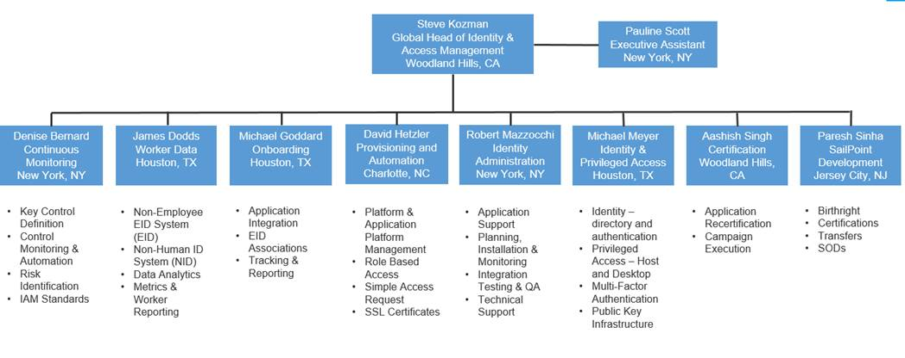
The Identity & Access Management Provisioning & Automation team
The provisioning team is primarily responsible for access administration for in-scope applications and platforms.
The team is located in the United States, Malaysia (Kuala Lumpur) and India (Chennai/Bangalore)
As 2019 : IAM Provisioning and Automation for in-scope below activities:
CA-1402840- User Access Provisioning – via Service Now
CA-1402840 - User Access Provisioning - via CASL
Using below tools:
Service Now

Slide 2
Application & Platform Provisioning KPIs
Platform Name | Population supported
Active Directory domains | 19 domains (279K accounts)
Windows servers | 14,720 Servers
UNIX Centrify and eTrust | 468 eTrust + 6738 Centrify servers = 7,206 servers.
 | 16K accounts
Remote Access | 39,235 RSA SecurID (Two factor authentication)
 | 269 Radius authentication Users
Mainframe Top Secret | 28 lpars
Mainframe RACF | 10 lpars
Mainframe zVM | 17 lpars
iSeries / AS400 | 14 lpars (full IAMPA support)
 | 32 lpars (compliance checks only)
SSL certificates | ~3,014 certificates
GEAR application provisioned
Investments and Corporate IT | 92
General Insurance | 92
Life and Retirement | 76
Infrastructure Services | 3
 | 263
QA Evaluations
Number of QA Evaluations | 1,224
Number of People Evaluated | 47
Requests Subject to Evaluation | 22,017
Ticket source | Current Month | 2019 YTD
ServiceNow Requests | 23,240 | 88,532
ServiceNow Incidents | 1,801 | 7,063
CASL Requests (GI request tool) | 6,603 | 23,110
JIRA Requests (ICIT request tool) | 251 | 1,099
Total Tasks Completed | 31,895 | 119,804
Average Single Day Processing % | 78.3% | 82.6%
Service Level Agreement Achieved % | 99.1% | 99.0%
Average QA Score | 97.7% | 97.9%

Slide 3
Control Review Overview
The purpose of the Control Review process is to refresh requirements for each application and platform service at a minimum of 18-month intervals
The information captured from Control Reviews will be used to update departmental documentation, validate that application entitlements are complete, current, and accurate, as well as identify any entitlements or attributes that can cause Segregation of Duties (SoD) issues or present toxic combinations
Updates to provisioning documents for completed reviews should be sent to submitted using the “Admin procedure change tracker” in IAM SharePoint
The following key components of the request process are reviewed and recorded for each Control Review:
Request Form Attributes | Procedures
Approval Workflow | Administrative Access
Approvers | Revocations
Queues | Retention
SailPoint Certification Attributes | Review model IDs (legacy)
Agenda inquiry: Understanding process to maintain & update required approvers/approval groups

Slide 4



IAM user access provisioning process
Access request submitted
Approval workflow initiated via ServiceNow
Administrator receives ticket to provision access
What has changed?
IAM introduced the Simple Access Request method of ServiceNow
Requestors submit for access directly utilizing the self-service portal
Global BSA role was eliminated from the process
RCMS is no longer used as ticketing tool, all applications migrated to ServiceNow
Email access requests no longer accepted
Role automation implemented
Robotic provisioning automation
Agenda inquiry: RCMS/JIRA applications have been fully migrated to ServiceNow

Slide 5
Simple to use access request portal; enabling standardization, automation, agility, and improved controls
Simple Access Request
Why Simple Access Request?
Access request is a highly audited
Users had to navigate over 600 workflows across multiple portals
IAM processed 361,444 access requests in 2018
Reliance on open text and matching access to existing users
Automation was not feasible due to data quality and variation
Selected ServiceNow with standard workflows driven by GEAR data
Initial scope is IAM provisioned applications
Deployed ServiceNow search using GEAR data
Changed all existing catalogs to standardize user selection
Created standardized data driven access request workflows
Deployed 141 ICIT applications, enabling RCMS retirement (Nov ’19)
Deployed 109 GI applications (Feb ’19)
First structured request process not requiring manual BSA involvement
Deployed access inquiry catalog (Feb ’19)
77 L&R applications deployed (April/May ’19)
Will enable retirement of high maintenance legacy ServiceNow workflows
Open for non-IAM adoption (May ’19)
To include migration of existing ServiceNow access request catalogs
Platform requests (AD, Unix, Mainframe, etc) to be deployed (Q3 ’19)

Slide 6

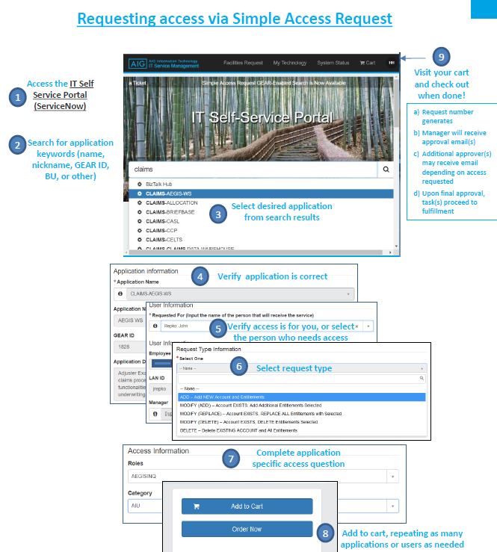

Request process
Agenda inquiry: Understand different assignment groups which perform provisioning.

Slide 7

Robotic Process Automation
The access provisioning process is automated using BluePrism and IPsoft tools
The Bots are configured to mimic human actions and do not change the behavior of the system or component.
Benefits:
1. Improved quality and accuracy of work
2. Reduce time cycles to complete tasks
3. Cost saving
 | Configure | Test | Implement | Monitor
User requests new RPA workflow | RPA team configures a workflow with required steps based on current state procedures to provision access to application XYZ. The Robot automates the business logic and process rules and starts with reading variables in the approved ServiceNow ticket. The robot then opens the specific application and performs the activities based on the ticket | IAMPA runs tests in lower environments to evaluate tickets are provisioned as expected | RPA configuration is added to Production environment | BAU QA team continually samples tickets, both human and RPA originated

Slide 8

Role Based Access - Pilot
Objective
Optimize end to end access assignment through the deployment of roles, utilizing HR job attributes to drive automation while strengthening controls and ensuring appropriate access.
What is a Role
Pre-defined, pre-approved applications and access levels the business unit requires to perform their daily functions based on the job role.
Scope
Identity & Access Management deployed a pilot business role for Life & Retirement Call Center to drive access assignment and removal driven by policy triggers.
Review and approvals
Role owner and blanket manager approval is required at role creation, modification and role decommissioning
Role owner is required to complete an annual role review of role criteria, owners and role contents
Benefits of roles
Pre-approved / pre-defined access
Automated role assignment and removal through HR attribute trigger
Mitigate potential risk of accumulated access
Direct provisioning / access removal capabilities
Simplify certification with focus on outlier access
Auto ticket generation

Slide 9
Quality Assurance process
QA Process Criteria
Randomized sample tickets to be statistically significant to the total requests and incidents volume (target 15 tickets per Security Administrator per month)
Tickets evaluated against criteria centered on accurate provisioning, appropriate approvals, use of standard closing comments and adherence to documented procedures
Extend QA process to applications and platforms with emphasis on high risk applications
Increased sample size for new hires to enable training and onboarding process, but exclude their evaluations from metrics for the first 90 days
Weekly reporting on QA scores, including summary of critical and non-critical errors
Overall monthly report to measure QA trends and average score
Review prior day sample tickets
Validate approvals, access granted, closing comments, process adherence
QA notifies access admins, lead and/or manager of deviations
Access admins correct, acknowledge, propose enhancements
Manager or lead review results, provide coaching, propose enhancements

Slide 10
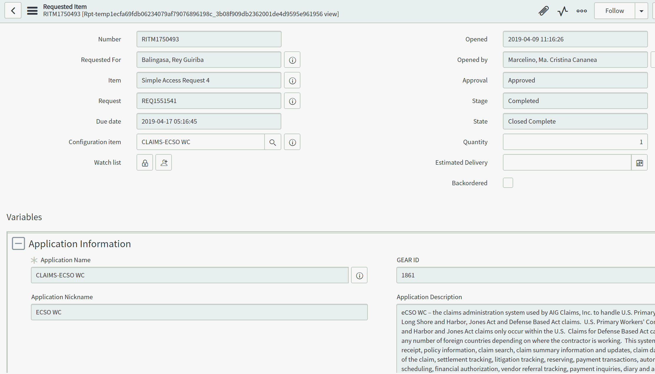
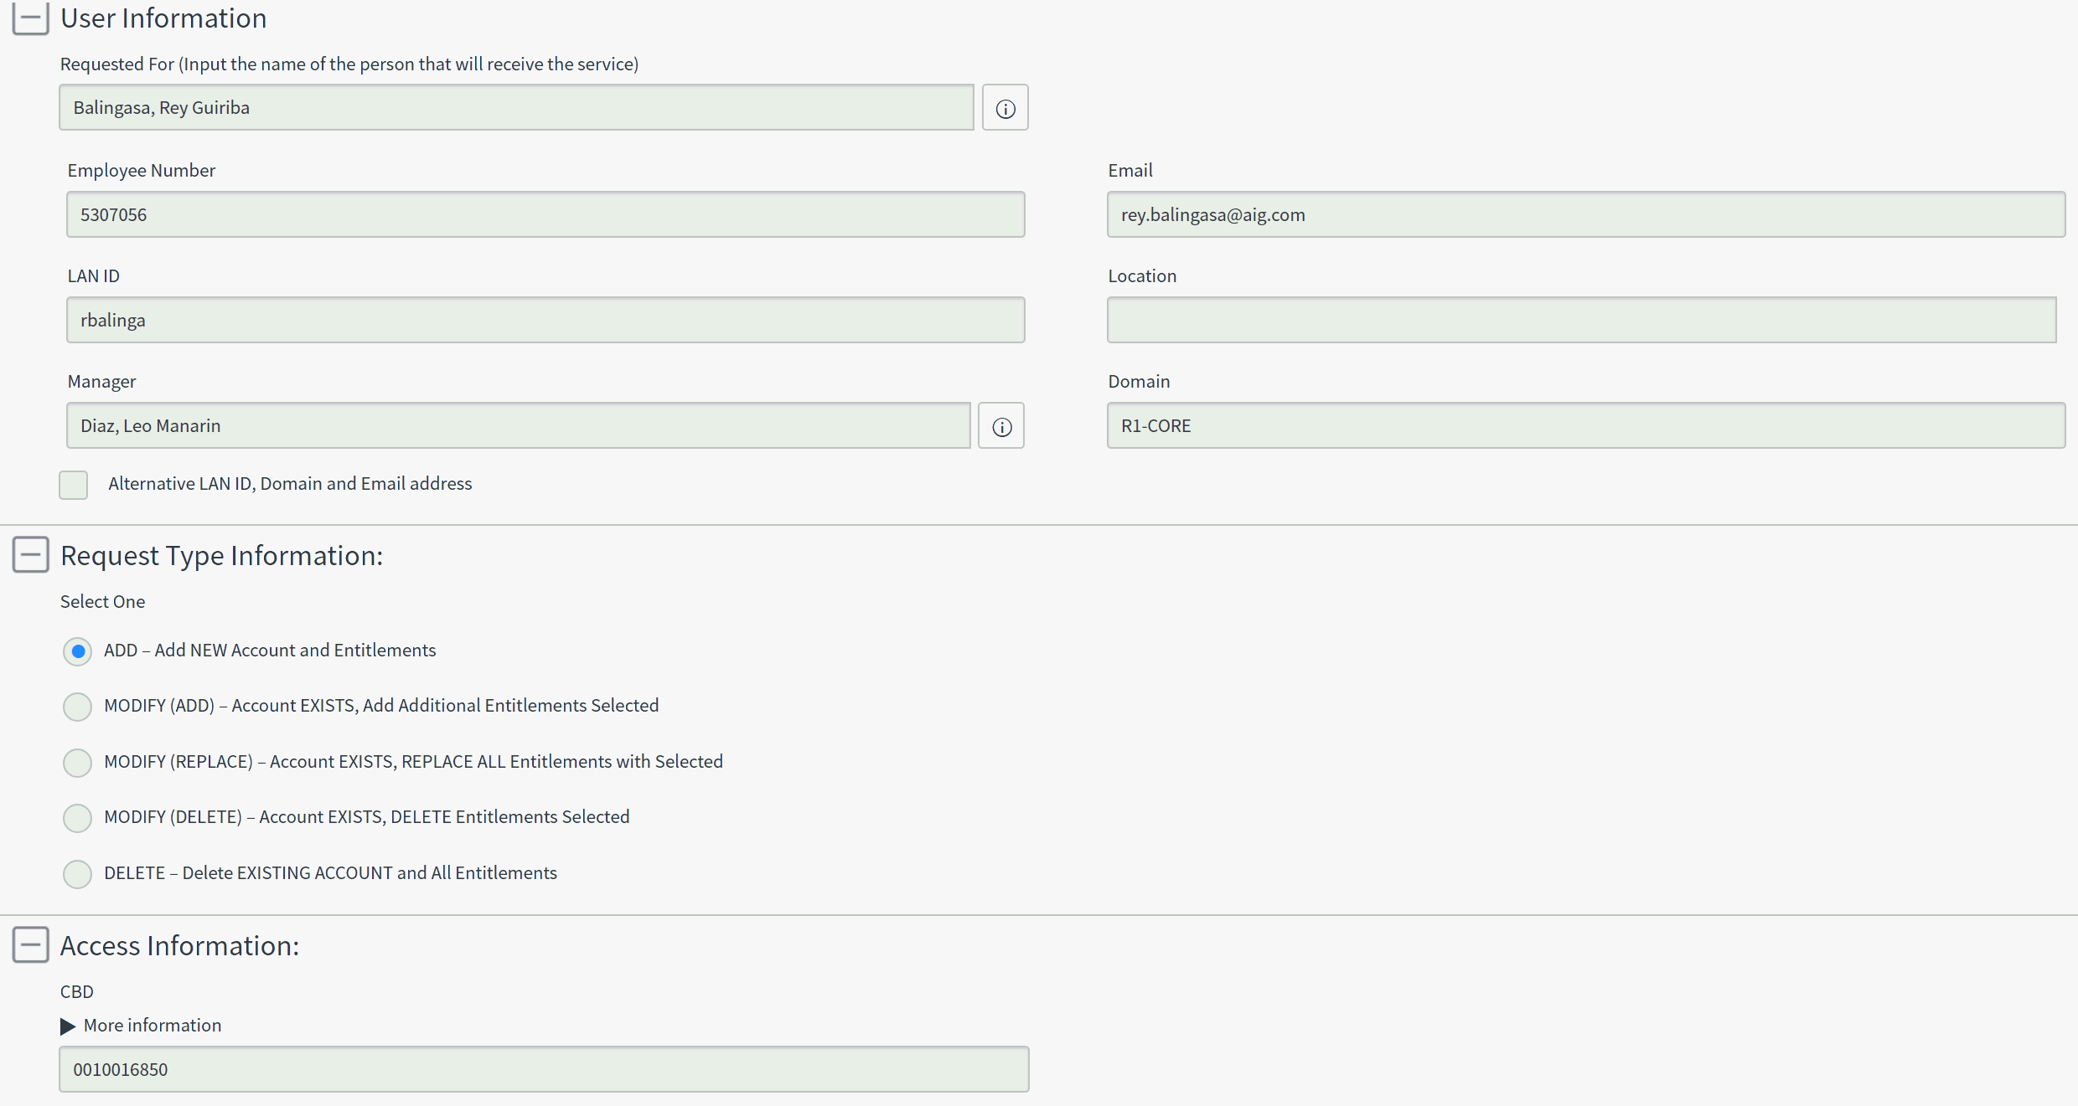
Provisioning Type: Application Access (Manual; IAM team; CASL) Ticket: REQ1551541/ RITM1750493 Application: CLAIMS-ECSO WC (Simple Access Request 4)

Slide 11
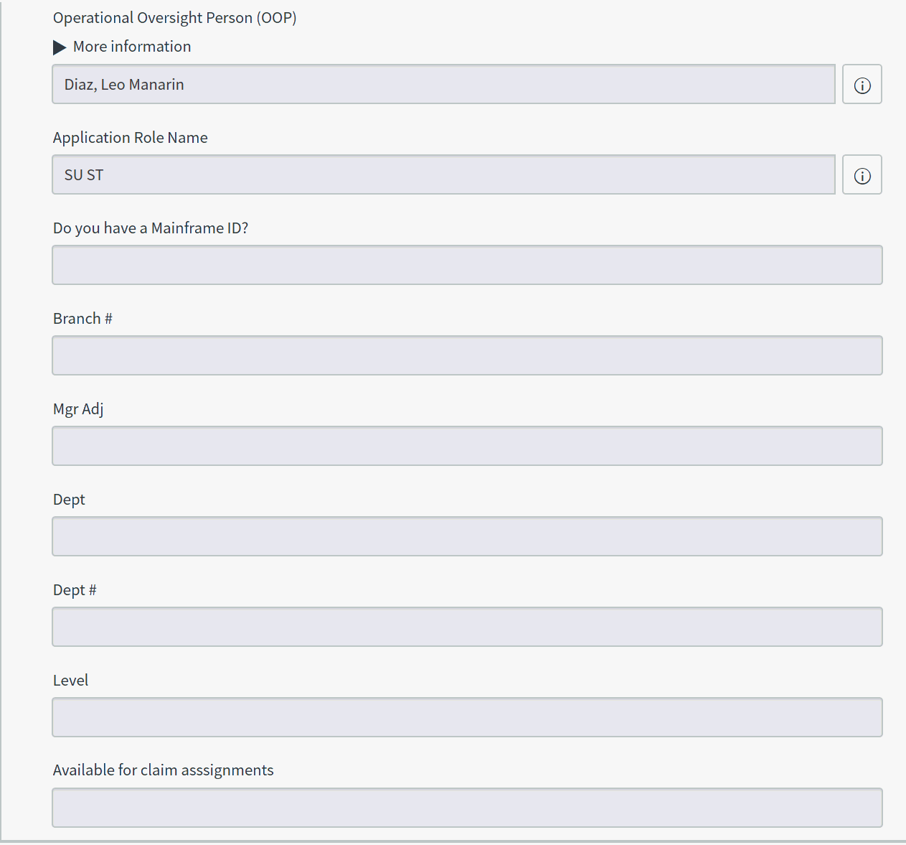
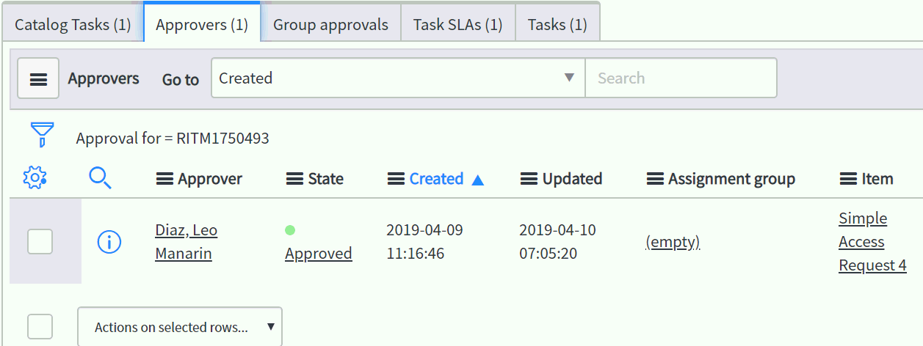
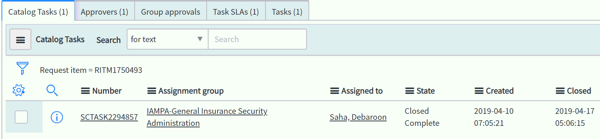

Slide 12
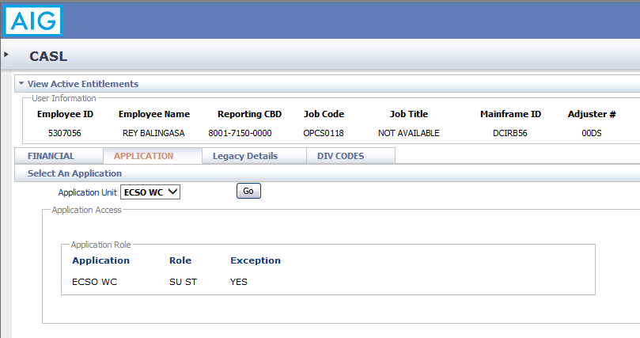
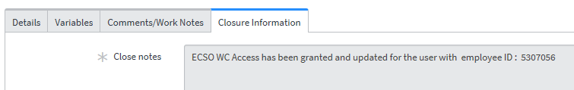

Slide 13
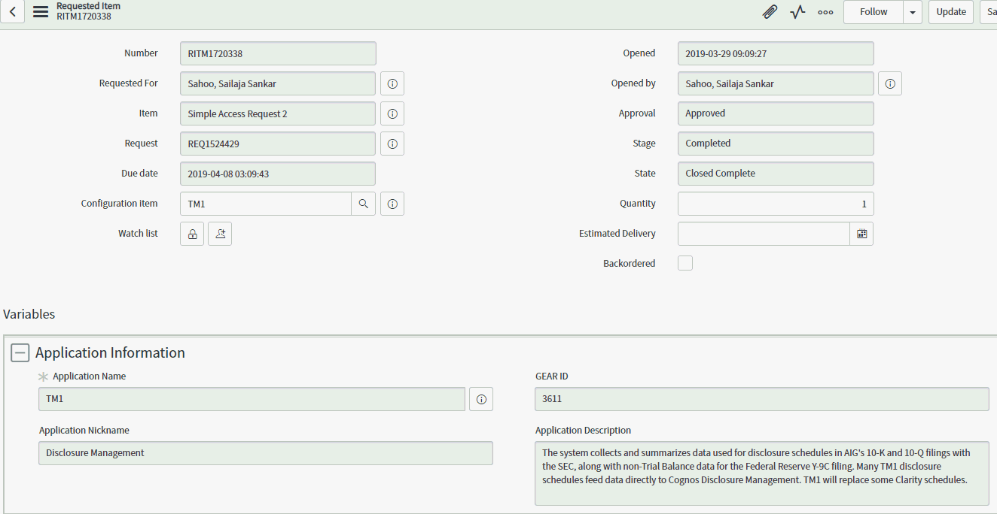
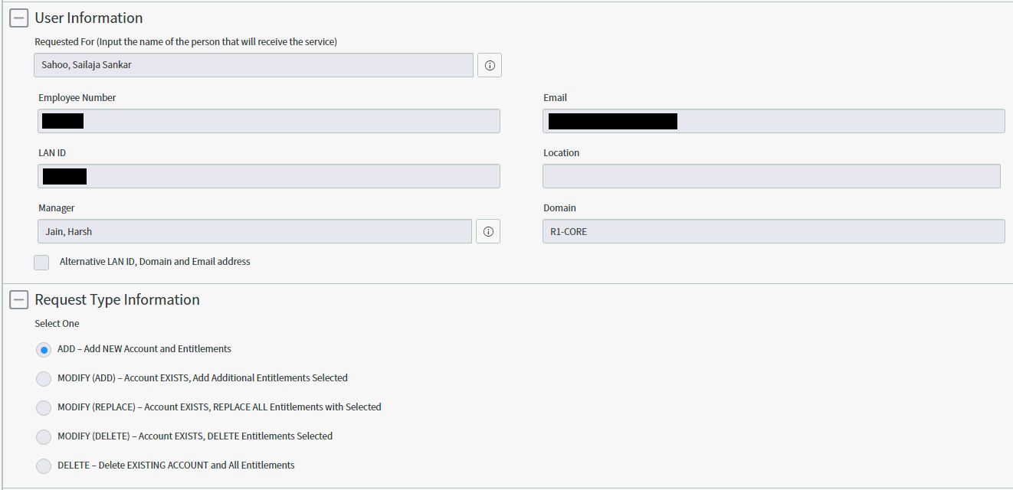
Provisioning Type: AD (Bot-Automated) and Application Access (Manual; Non-IAM Team) Ticket: REQ1524429 / RITM1720338 Application: TM1 (Simple Access Request 2)

Slide 14
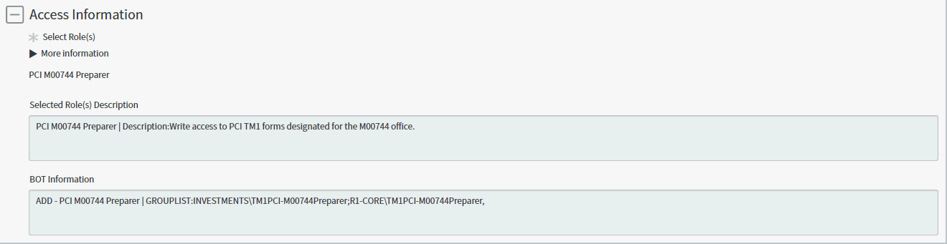
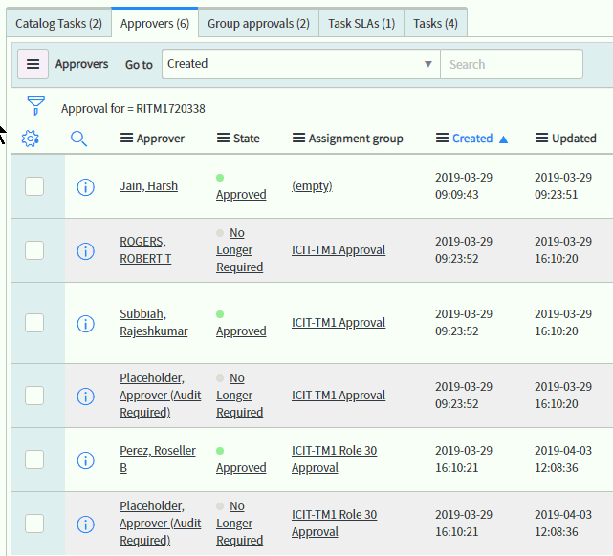
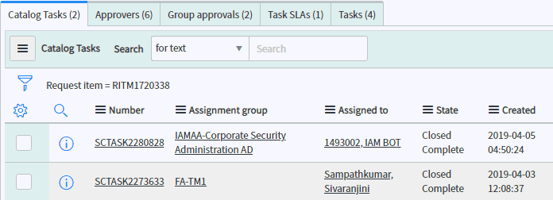

Slide 15
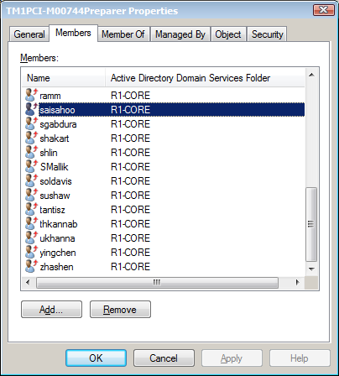
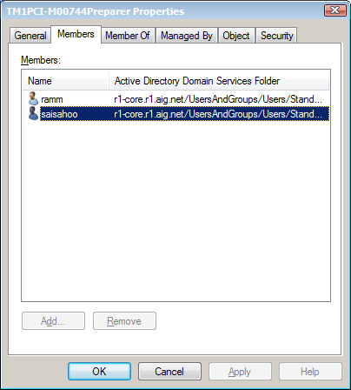
Access provided

Slide 16
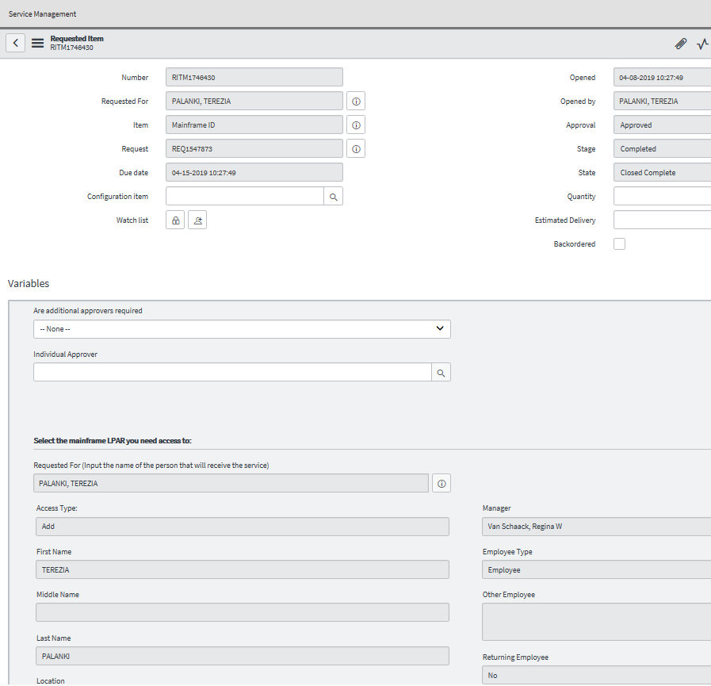
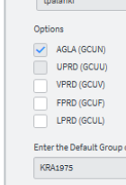
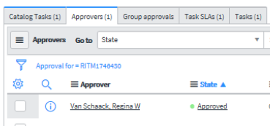
Provisioning Type: Mainframe ID (Manual; IAM Team) Ticket: REQ1547873/ RITM1746430 ServiceNow catalog

Slide 17
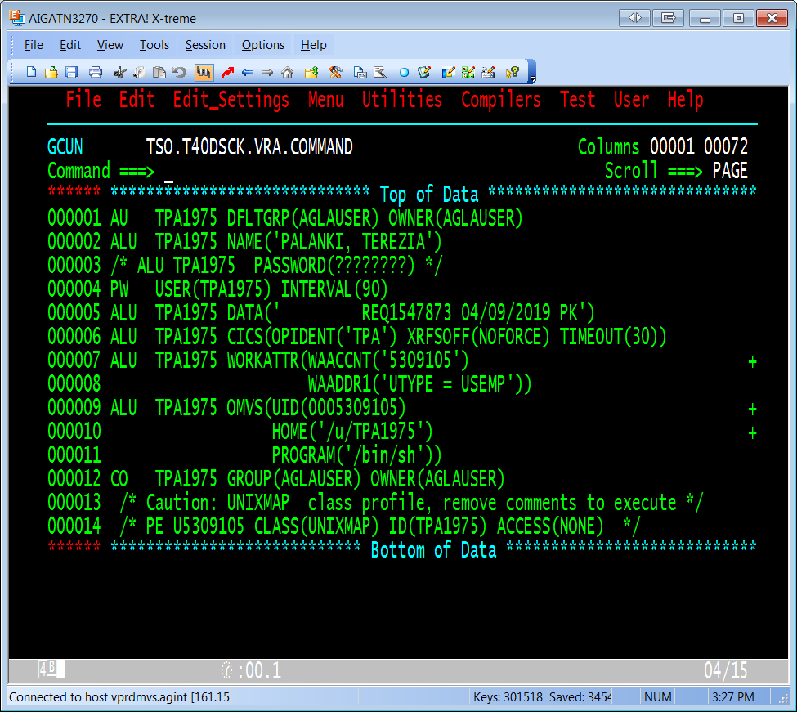
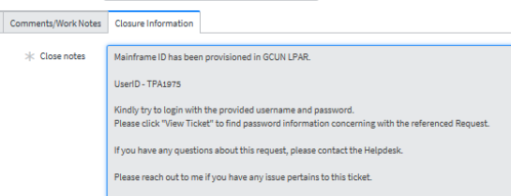
Mainframe ID completed

Slide 18
ICIT: ClearWater
Request process is via ServiceNow
Approvals are captured within ServiceNow, based on the workflow built during the application onboard to the ServiceNow tool
Access provisioning is handled by IAM Provisioning & Automation team
Assignment group: IAMAA-Corporate Security Administration
Once team receives the approved ticket via TASK, they will review the TASK
IAM PA sends the user details and the role required to ClearWater team via email
[ClearWater only accepts emails from IAM PA Team]
ClearWater team sets up the user in the application and assigns the ROLE requested, confirming once completed
IAM PA team will log into the application to assign all the Accounts that are available for user, these accounts are populated automatically according to the group that the user is placed under by ClearWater team per above step.
Save the user profile and send confirmation to the user with the access request completion & Login instructions.
Sample ticket embedded

Slide 19
ICIT: Electronic Banking Systems [EBS]
Request process is via ServiceNow
Line Manager Approvals are captured within ServiceNow, additional approvals captured manually and attached to the ticket.
Access provisioning is handled by IAM Provisioning & Automation team
Assignment group: IAMAA-Corporate Security Administration
Once IAM PA receives the approved ticket via TASK, they will review the TASK
If user requesting ‘Payment/Funds Transfer access’ then analyst will look for User’s Manager’s Manager approval. If it is not provided then it is requested manually and then attach that to the ticket
Upon Managers approval, Analyst will send the requested access details, approvals and Business Justification to designated Treasury Approver
Upon Treasury approval, analyst will proceed with user setup in the application, Another analyst will approve the setup within application [application specific, not every application requires secondary approval].
Analyst will send confirmation to the user with the access request completion & Login instructions.
Sample ticket embedded

